Slide 1

Why
C#
.NET
.NT CORE
AGULAR
TYPESCRIPT
Notes:
https://www.linkedin.com/pulse/15-reasons-why-you-should-learn-c-2023-andrea-angella/

Slide 2


Slide 3


Slide 4


Slide 5


Slide 6


Slide 7


Slide 8


Slide 9



Slide 10



Slide 11



Slide 12


Slide 13


Slide 14


Slide 15


Slide 16


Slide 17


Slide 18


Slide 19


Slide 20
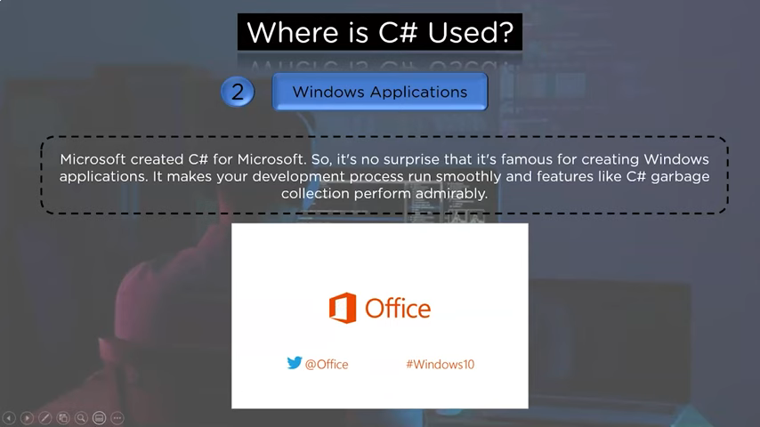

Slide 21


Slide 22


Slide 23
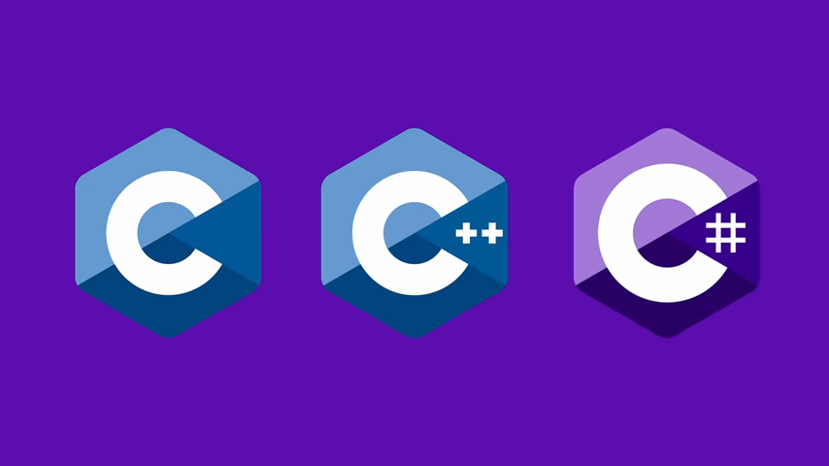

Slide 24


Slide 25


Slide 26
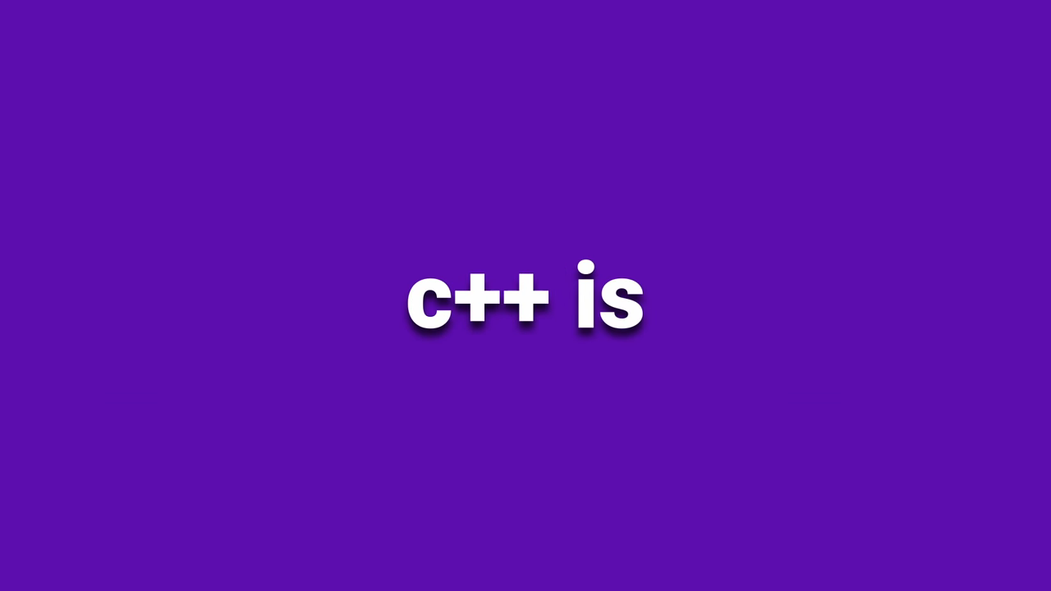

Slide 27


Slide 28
Are they all same languages?
Is C# an upgraded version of C as C++ is?
Are these languages interdependent?
What is ideal in order to learn these languages?
Is knowledge of C & C++ is must to learn C#?
Which one is better C or C++ or C#?
What is the difference between C vs C++ vs C#?
Notes:
https://copyassignment.com/c-vs-cpp-vs-c-sharp/

Slide 29
Notes:
https://copyassignment.com/c-vs-cpp-vs-c-sharp/

Slide 30
Notes:
https://copyassignment.com/c-vs-cpp-vs-c-sharp/

Slide 31



Slide 32



Slide 33



Slide 34



Slide 35



Slide 36



Slide 37


Slide 38


Slide 39
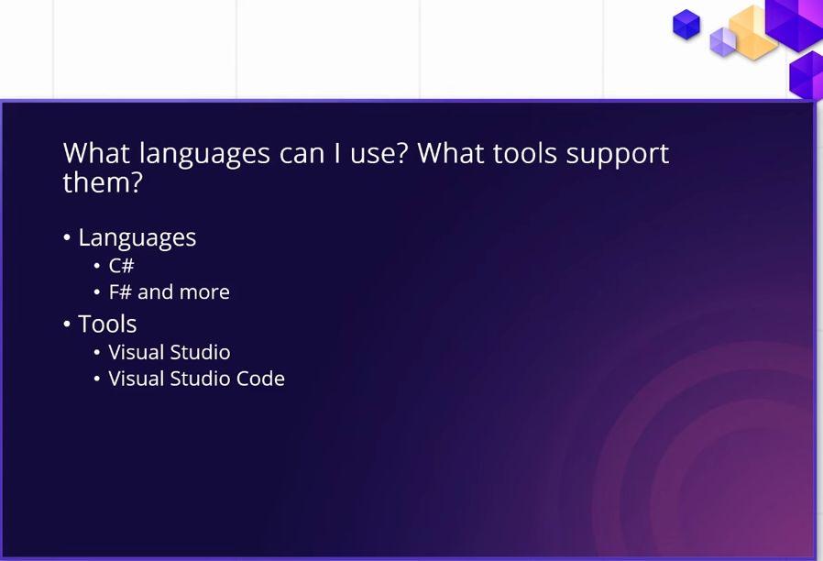

Slide 40


Slide 41
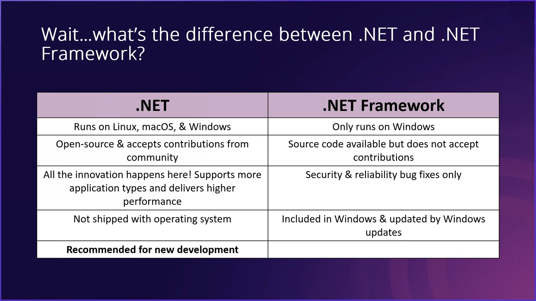

Slide 42
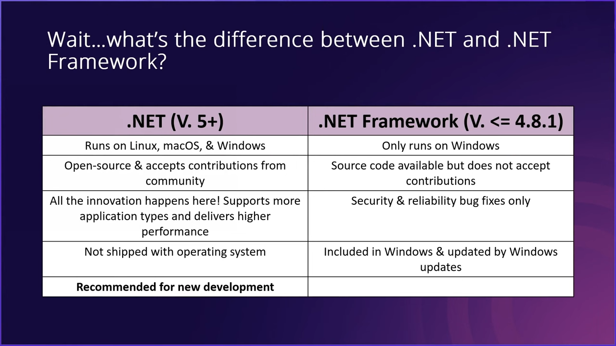

Slide 43


Slide 44

Its confusing but here it is in a nutshell
NET Framework is .net versions ≤ 4.8 and is Windows only
NET ≥ 5 is really .net core and .net 8 is being released recenly (it can run on Windows or Linux and Mac too)
Don't use .NET Framework unless you have a specific use case or a legacy project. Since you are new just use .net ≥ 6 which is essentially .net core and is now considered "regular" .NET (Its confusing, I know).

Slide 45
You should target the latest .NET (7 at the moment).
Older versions are called .NET Framework and are only needed if you work in old projects. These are Windows only.
.NET Core is a name used to distinguish between the two during the transitioning, but IMO the name is no longer needed.
.NET 7 can be used in any IDE or even command line. But best IDEs are Visual Studio (Community Edition for you) and Rider.

